Slide 1
FURNITURE in the house

Slide 2
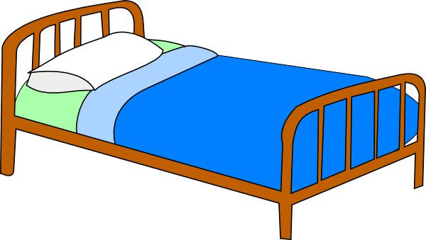
“What is it?”
bed
sofa
desk

Slide 3
“What is it?”
bed
chair
sofa

Slide 4
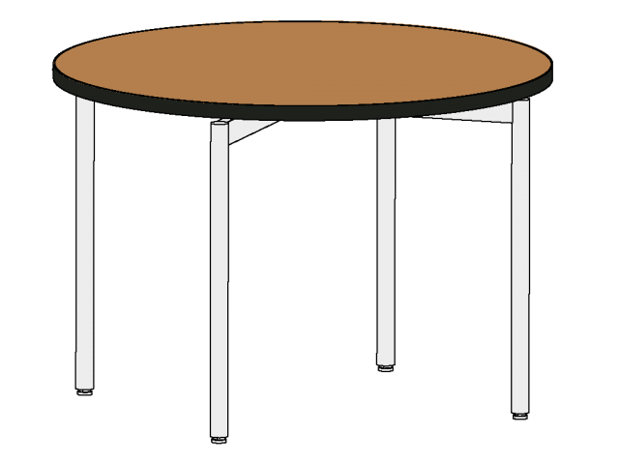
“What is it?”
Shelf
Desk
Table

Slide 5
“What is it?”
bed
chair
sofa

Slide 6
“What is it?”
bed
chair
sofa

Slide 7
“What is it?”
Sofa
Armchair
Chair

Slide 8
“What is it?”
Sofa
Armchair
Chair

Slide 9
“What is it?”
Wardrobe
Shelf
Bookcase

Slide 10
“What is it?”
Wardrobe
Shelf
Bookcase

Slide 11
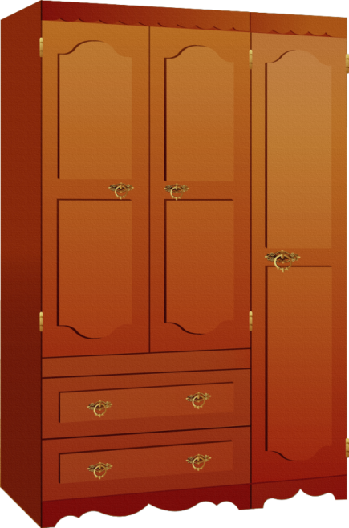
“What is it?”
Carpet
Wardrobe
Bookcase

Slide 12
“What is it?”
Sofa
Carpet
Chair

Slide 13
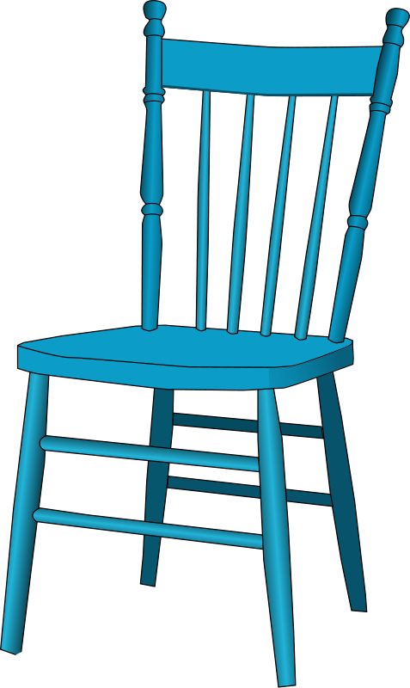
“What is it?”
Bed
Chair
Arm - chair

Slide 14
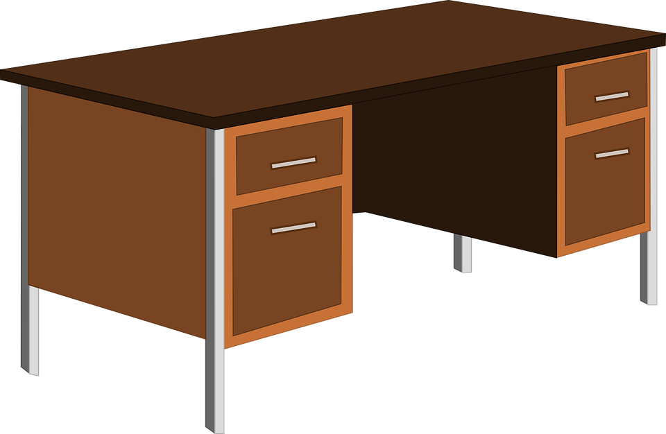
“What is it?”
Table
Bed
Desk

Slide 15
“What is it?”
Bookcase
Shelf
Table

Slide 16
“What is it?”
Table
Lamp
Carpet

Slide 17
“What is it?”
Mirror
Shelf
Table

Slide 18
Shelf
Carpet
Picture

